Slide 1
Datatypes in Python

Slide 2
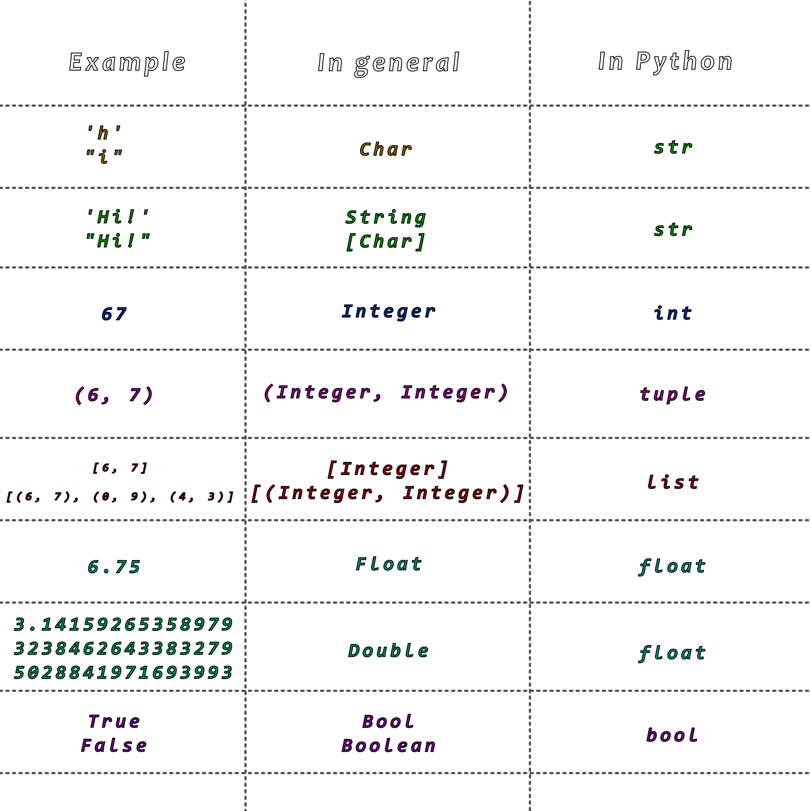

Slide 3
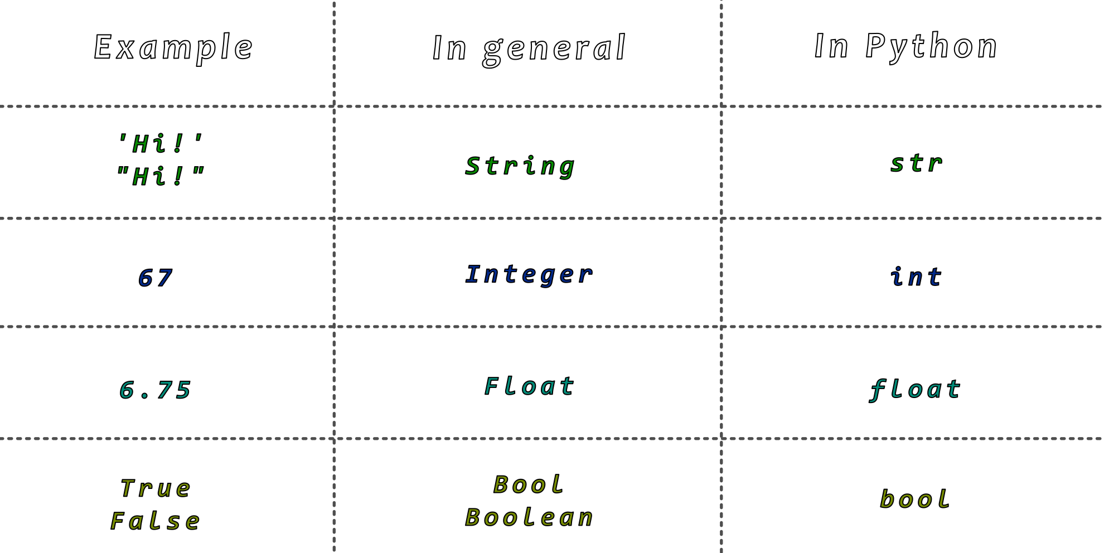

Slide 4
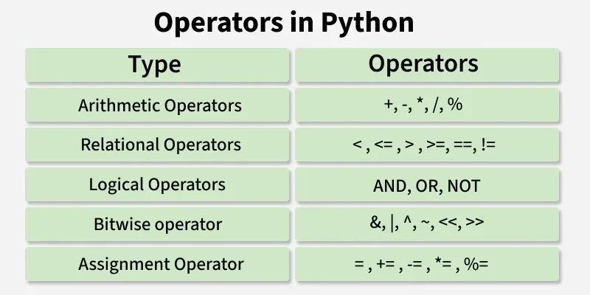
Operators in Python

Slide 5
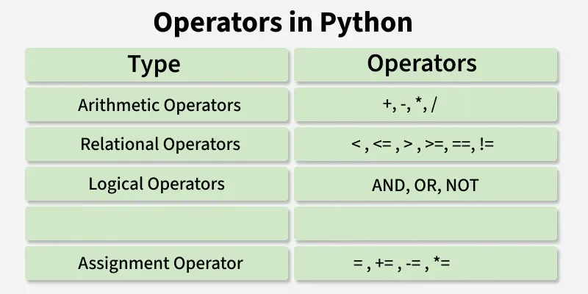
Operators in Python
The most important ones…

